Slide 1
Chapter 1
The Review Game

Slide 2
Geography Skills
The Earth is divided into imaginary lines that are horizontal and labeled as north and south. These lines are called…

Slide 3
Geography Skills
Latitude

Slide 4
Geography Skills
Line on a map that is marked off to show actual distances between two points on a map.
Ex)

Slide 5
Geography Skills
Scale

Slide 6
Geography Skills
This type of map (map projection) is round

Slide 7
Geography Skills
Robinson Projection

Slide 8
Geography Skills
The Earth is divided into imaginary lines that are vertical and labeled as east and west. These lines are called…

Slide 9
Geography Skills
Longitude

Slide 10
Geography Skills
Using the following map, what country is located at: 60N, 100W

Slide 11
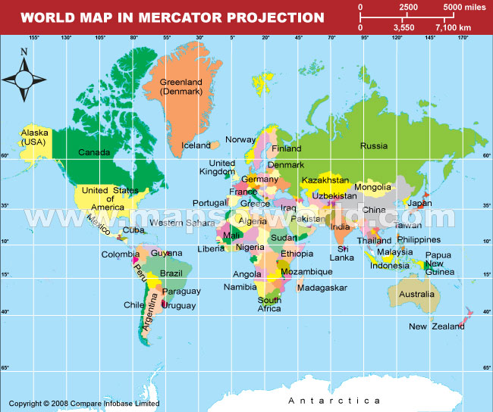
What Country? 60°N,100°W

Slide 12
Geography Skills
Canada

Slide 13
Geography Skills
What county is located at:
35°N, 95°E

Slide 14
What Country? 35°N, 95°E

Slide 15
Geography Skills
China

Slide 16
Vocab
Name for the period of time before man began to keep written records

Slide 17
Vocab
Prehistory

Slide 18
Vocab
Something made by man (ex: diary, coins, art, tools)

Slide 19
Vocab
Artifacts

Slide 20
Vocab
Name of canyon where first tools by man were found

Slide 21
Vocab
Olduvai Gorge

Slide 22
Vocab
Anything created by man to make his life or a task easier (a tool or skill)

Slide 23
Vocab
Technology

Slide 24
Vocab
Way of life for a society: their values, beliefs, and practices

Slide 25
Vocab
Culture

Slide 26
Vocab
Creatures that stand upright and walk on two feet all the time

Slide 27
Vocab
Hominids

Slide 28
Vocab
Skeleton found to be one of the first hominids

Slide 29
Vocab
Lucy

Slide 30
People
Scientist who discovered Lucy

Slide 31
Donald Johanson

Slide 32
Hominids
Hominid also known as, “Handy Man”

Slide 33
Hominids
Homo Habilis

Slide 34
Hominids
Hominid who first used fire and made more complex tools like the hand ax

Slide 35
Hominids
Hominid who developed cave art and is most closely related to modern humans

Slide 36
Hominids
Homo Sapiens

Slide 37
Vocab
Name for a period of time that lasted from 2 million B.C.E. to 10,000 B.C.E.

Slide 38
Vocab
Paleolithic Era

Slide 39
Vocab
Name for the period of time that lasted from 10,000 B.C.E. to about 3,000 B.C.E. (when writing was first developed)

Slide 40
Vocab
Neolithic Era

Slide 41
Vocab
Another name for the Paleolithic Era

Slide 42
Vocab
Old Stone Age

Slide 43
Vocab
Someone who travels from place to place in search of food and water

Slide 44
Vocab
Nomads

Slide 45
Vocab
Ancient belief that spirits inhabit plants and animals

Slide 46
Vocab
Animism

Slide 47
Vocab
Raise or train animals to help man and serve his purposes

Slide 48
Vocab
Domesticate

Slide 49
Vocab
Name for the major change in how man lives when he stops being a nomad and settles down in and lives in one place because now he’s a farmer

Slide 50
Vocab
Neolithic Revolution

Slide 51
Fun Facts
First animal domesticated by man

Slide 52
Fun Facts
Dog

Slide 53
Vocab
When you have more than you need of something, you have a…

Slide 54
Vocab
Surplus

Slide 55
Vocab
Type of economy that depends on people doing the same thing, every day, with habits and customs, and doesn’t change over time

Slide 56
Vocab
Traditional Economy

Slide 57
Vocab
A complex, highly organized social order. One of the primary characteristics is the existence of cities

Slide 58
Vocab
Civilization

Slide 59
Civilizations
Name two of the basic features that define civilization

Slide 60
Civilizations
Name two more of the basic features that define civilization

Slide 61
Civilization
7 Features:
Organized Governments
Complex Religions
Job Specialization
Social Classes
Arts and Architecture
Public Works
Writing

Slide 62
Civilization
Name one environmental event that can affect civilization

Slide 63
Civilization
Examples include earthquake or volcano as natural disasters, or drought or flood as weather

Slide 64
Civilization
Name the four ancient river valley civilizations

Slide 65
Civilizations
Sumer
Indus
Egypt
Huang

Slide 66
Civilizations
Which ancient river valley civilization was formed along the Tigris and Euphrates rivers?

Slide 67
Civilization
Sumer

Slide 68
Civilization
This person would record (on paper or in stone) the decisions of rulers or history of a people

Slide 69
Vocab
Scribe

Slide 70
Vocab
A city and the surrounding area including farm land

Slide 71
Vocab
City-State

Slide 72
Vocab
Several city-states or regions all under control of the same government or ruler

Slide 73
Vocab
Empire

Slide 74
Vocab
What its called when cultures mix and share ideas with each other

Slide 75
Vocab
Cultural Diffusion

